Slide 1

Lernify – A YouTube-Based Educational Platform
Presentation by: BATCH-09
VARDHAN - 231fa04618 LIKHITHA - 231fa04665
SUBANI - 231fa04692
SANDHYA - 231fa04g20

Slide 2
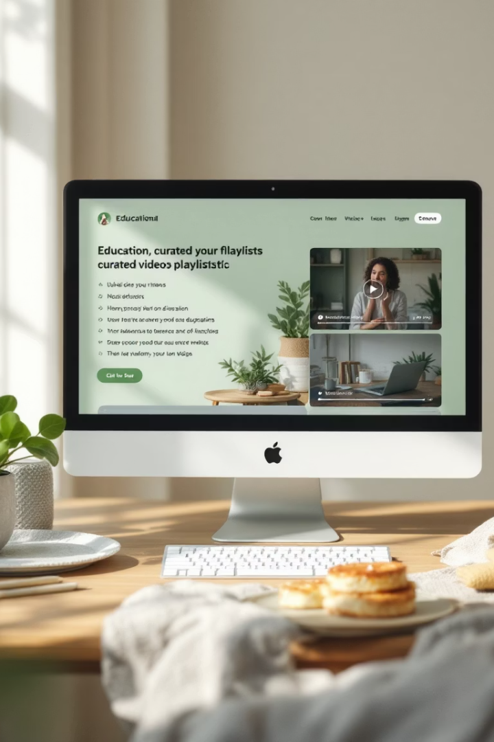
What is Lernify?
Curated Content
Static site delivering handpicked YouTube videos.
Easy Access
Top Courses and Top Subjects accessible directly.
No Login Needed
Click and learn immediately, no backend required.
Example Course

Slide 3

Problem: YouTube Overload
Too Much Content
Finding quality videos is overwhelming and time-consuming.
Distractions
Ads, comments, and recommendations distract learners.
Unstructured Learning
No clear subject-wise content organization on YouTube.
Time Wasted
Average user spends over 15 minutes searching endlessly.

Slide 4


Our Solution: Lernify's Objectives
Streamline Learning
Remove Distractions
Curated video playlists for faster knowledge gain.
Ad-free, comment-free environment for focused study.
Structured Paths
Example
Organizing YouTube into clear subjects and courses.
Learn html css and javascript in only 1 video

Slide 5





Key Features
Hand-picked Videos
Ad-Free Experience
Categorized Learning
Quality-assured content selected by experts.
No ads or distracting comments.
Sorted by subject and skill level.
Personal Suggestions
User Reviews
Customized learning paths recommended.

Slide 6
Value Proposition
Save Time
Focus Better
Discover Quality
Avoid endless YouTube searches.
Distraction-free learning environment.
Peer-vetted high-quality
content.
Cost Effective
Skill Growth
Free YouTube resources
organized efficiently.
Gain new skills quickly via
expert-selected courses.

Slide 7

Learnify's User-Centric Approach
Quick Content Access
Primary goal for all users seeking education.
YouTube Integration
Seamless video delivery within familiar platform.
Two Core Journeys
Designed for efficiency and user satisfaction.
1
2
3

Slide 8

Path 1: Direct Access - Quick Start
User Goal
Instantly find popular courses with minimal effort.
Navigation Path
Homepage → Top Courses / Top Subjects → YouTube video.
User Experience
One click access, ideal for users with clear goals.
Path 2: Full Journey - In-Depth Discovery
User Goal
Explore subjects and courses in detail before choosing.
Navigation Path
Homepage → Course → Subject → Subject Description → YouTube.
Experience
Supports comprehensive browsing and informed decisions.

Slide 9
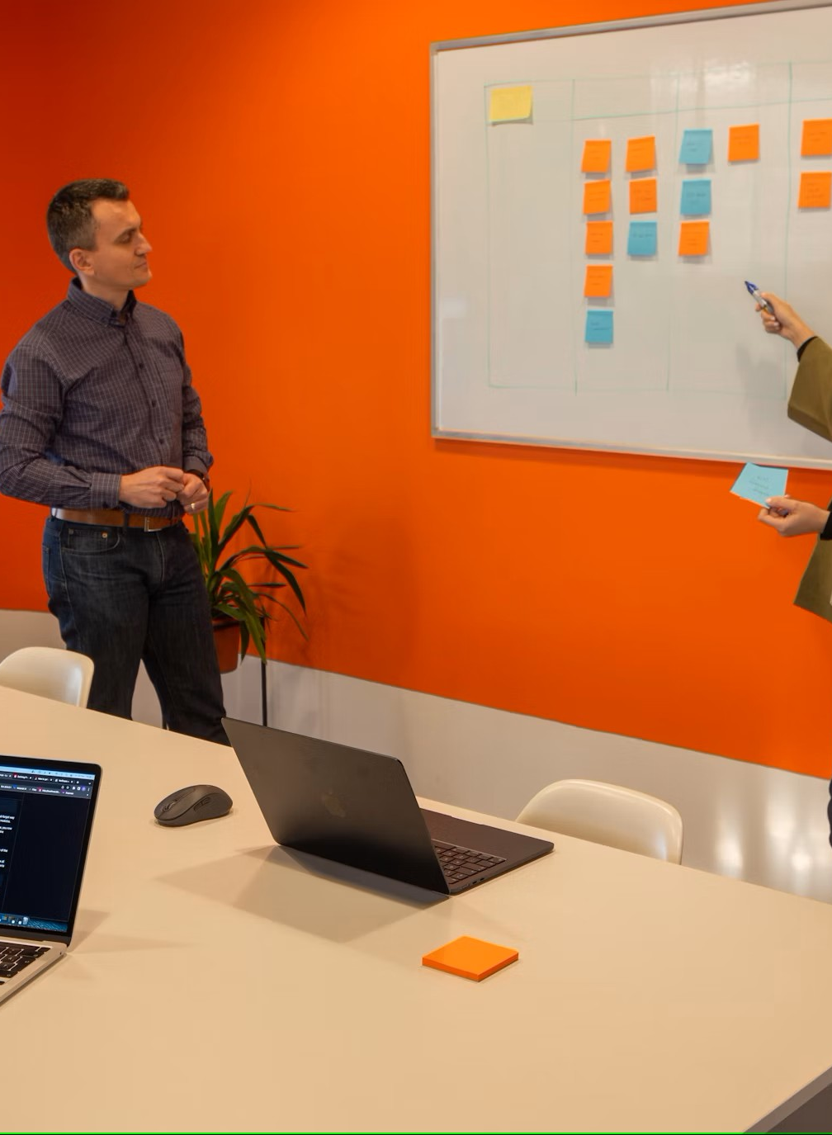
Website Architecture
DiagramUse block diagram showing:
Homepage → Course → Subject → View Page → YouTube
OR
Homepage → Top Courses / Top Subjects → YouTube

Slide 10

Technologies Used
Technology | Purpose
HTML | Page structure
CSS | Styling & Layout
JavaScript | Redirection
Firebase / GitHub Pages | VERCEL

Slide 11
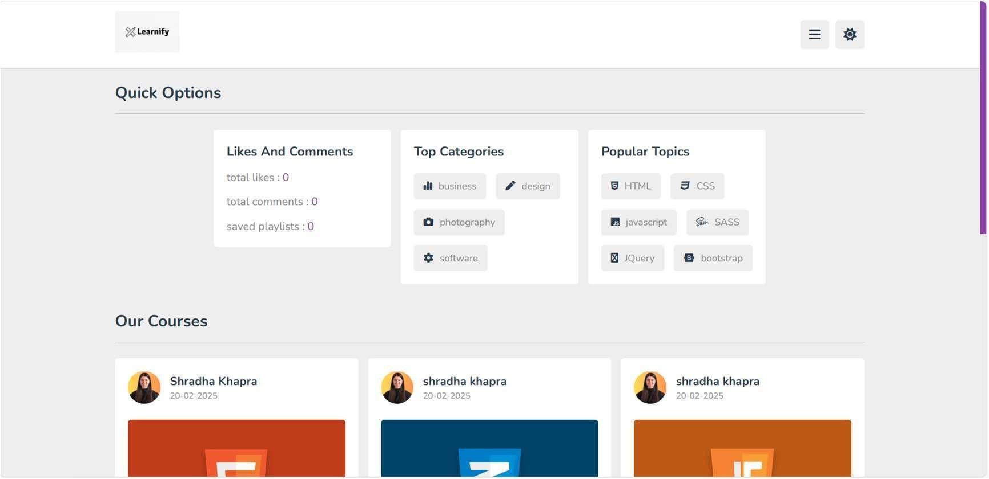
Homepage Screenshot
Show layout with:
Top Courses
Top Subjects
Navigation bar / header
Footer

Slide 12

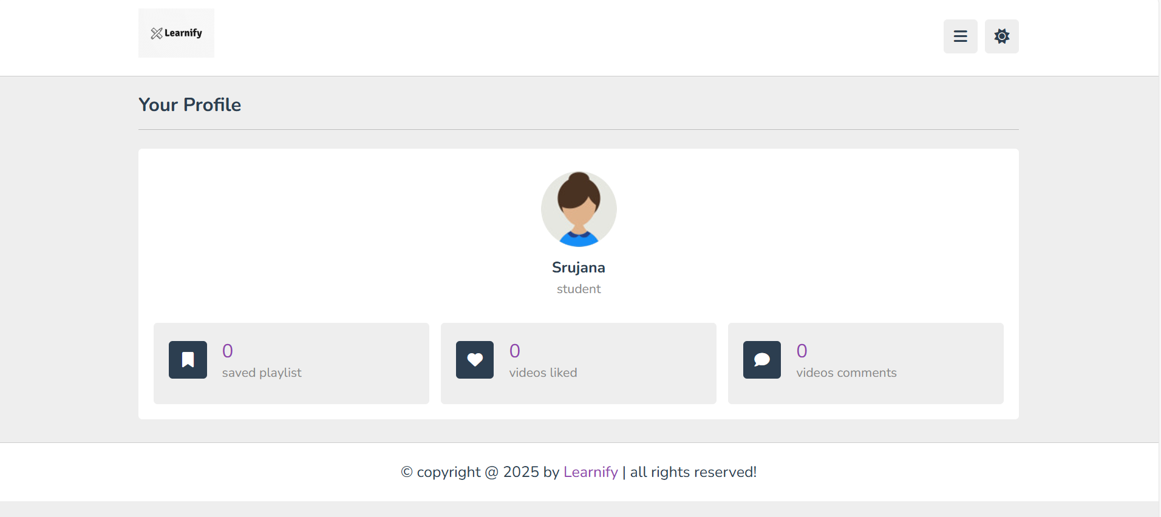
Static Student Profile Section
Display: profile image and student name (hardcoded)
No login or backend – for personal touch only

Slide 13

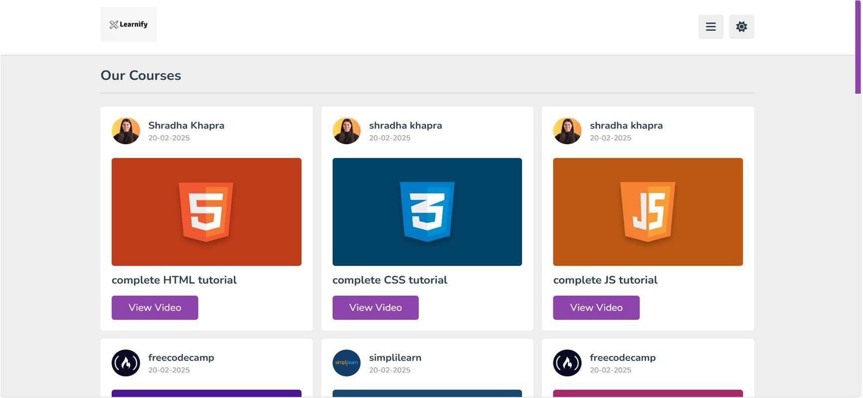
Course Selection Page
Shows list of available courses
Click on course → goes to subjects under it

Slide 14
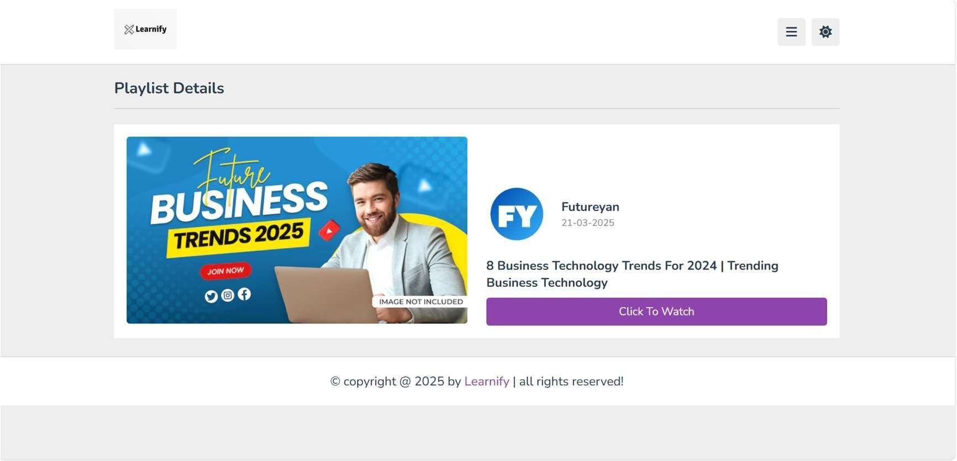
Subject Page with Description
Show subject layout
Include 4-5 line subject description
Highlight the “View Video” button

Slide 15
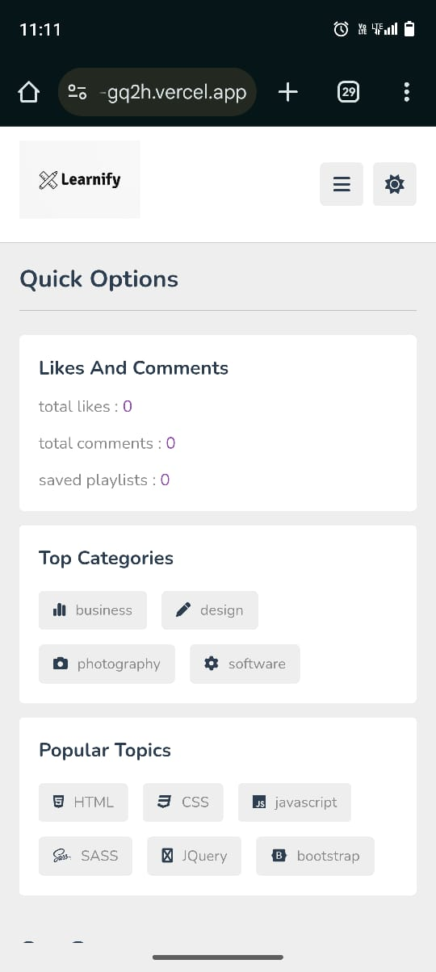
Mobile Responsiveness
Show screenshot of mobile view
Explain media queries / responsive grid or flexbox layout

Slide 16

Challenges & Solutions
Challenge | Solution
No backend | Used hardcoded data and links
Layout on small devices | Handled with CSS media queries
Video organization | Structured using pages and buttons

Slide 17

Outcomes & Future Scope
Outcomes:
Fully working static site
Fast, simple navigation
Clean UI with YouTube integration
Future Scope:
Add backend with user login
Admin panel to upload/update video links
Progress tracking and search features
Convert to full LMS

Slide 18

Conclusion & Thank You
Lernify organizes YouTube learning content into a clean experience
Easy access, distraction-free
Ready to expand into a full educational platform
Thank you! Any questions?

